Slide 1

CUAI Andrew Ng Machine Learning
2022.05.24
발표자 : 김벼리

Slide 2
내용
1. 스터디원 소개 및 만남 인증
2. 스터디 진행 상황
3. Support Vector Machine
4. Unsupervised Learning
5. Dimensionality Reduction

Slide 3
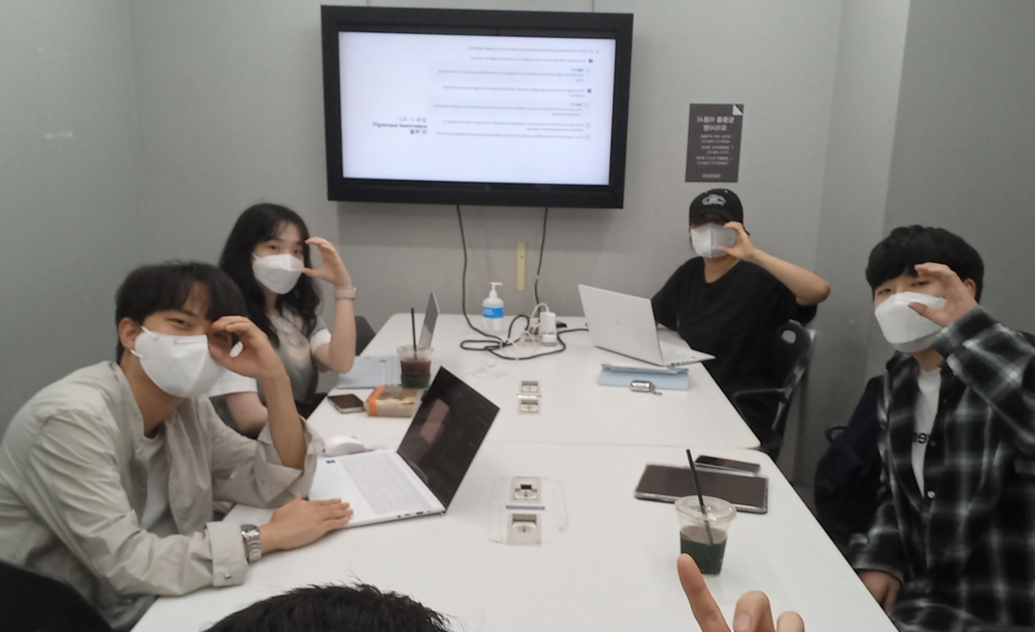
스터디원 소개 및 만남 인증
스터디원 1 : 김벼리(융합공학부)
스터디원 2 : 김유선(기계공학부)
스터디원 3 : 김휘중(경영학과)
스터디원 4 : 박정현(응용통계학과)
스터디원 5 : 이강민(산업보안학과)

Slide 4

스터디 진행 상황
이번 주: Anormaly Detection, Recommender Systems
다음 주: Large scale machine learning, Application Example: Photo OCR (완강!)

Slide 5
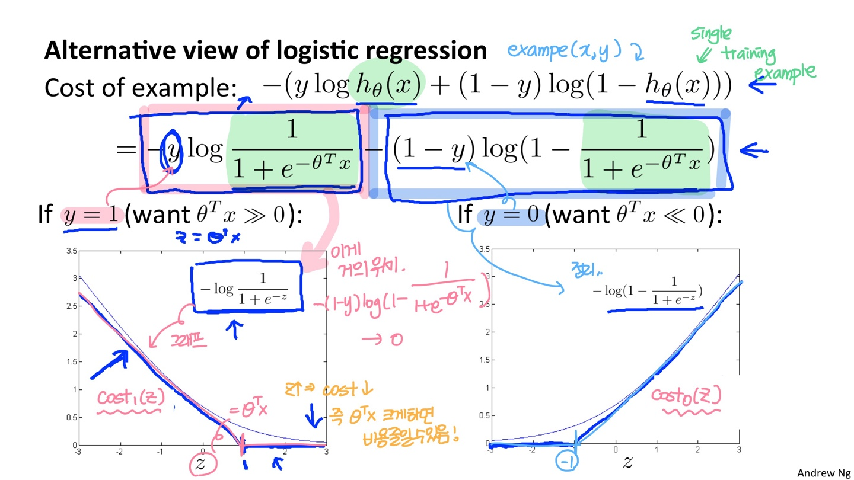
Support Vector Machine(Optimization Objective)

Slide 6
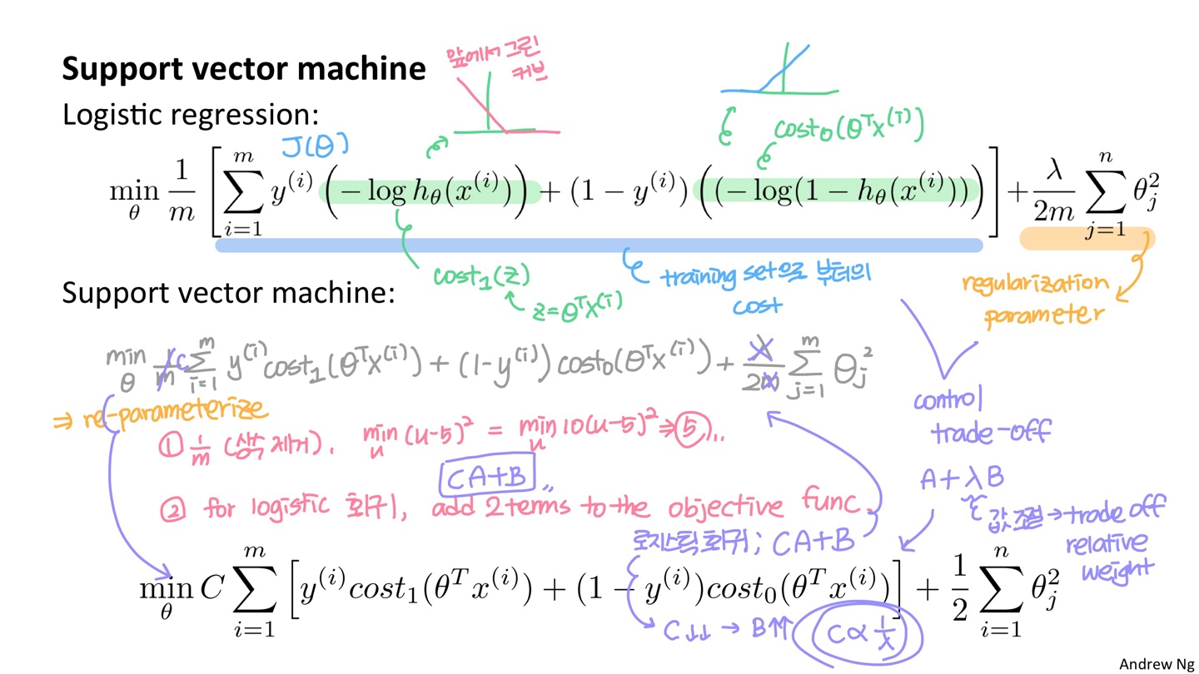
Support Vector Machine(Optimization Objective)

Slide 7
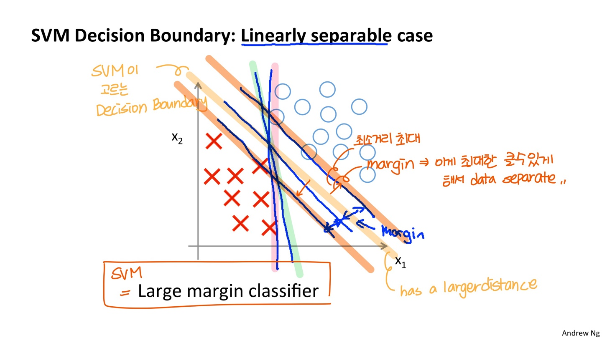
Support Vector Machine (Large Margin Intuition)

Slide 8
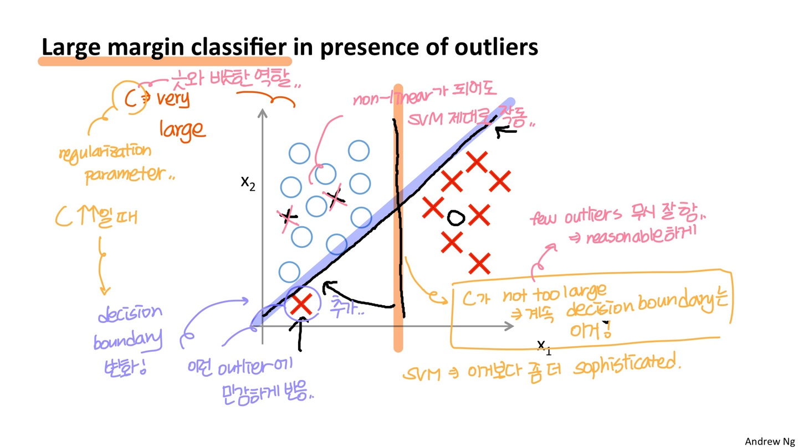
Support Vector Machine (Large Margin Intuition)

Slide 9
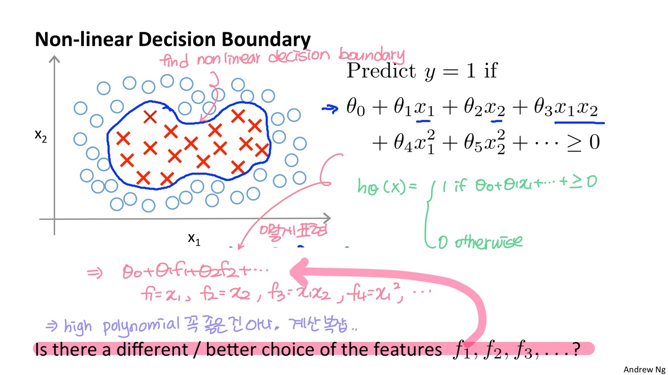
Support Vector Machine (Kernels)

Slide 10
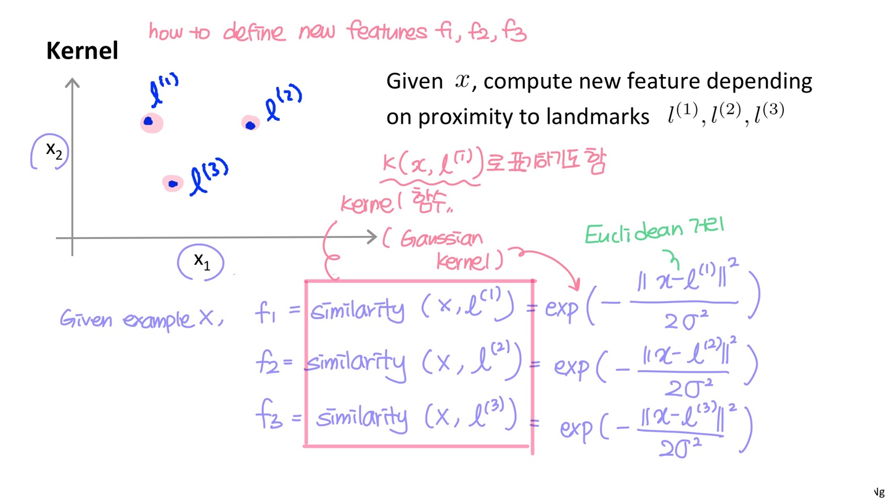
Support Vector Machine (Kernels)

Slide 11
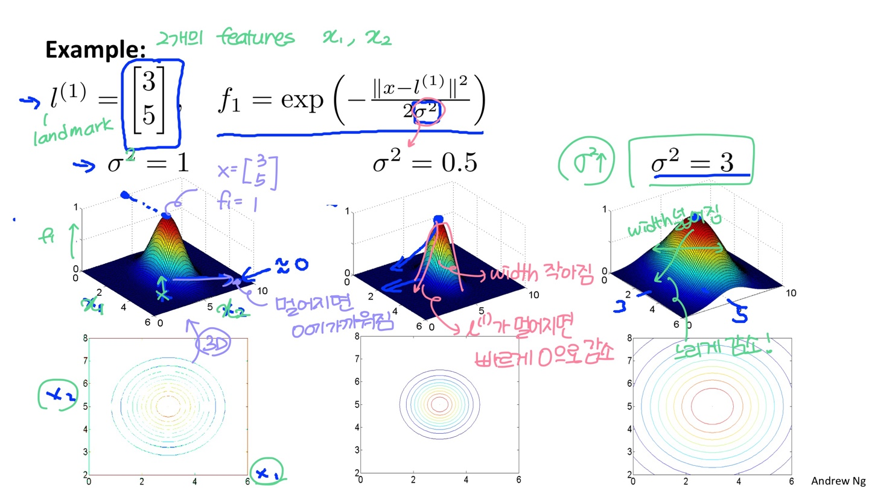
Support Vector Machine (Kernels)

Slide 12
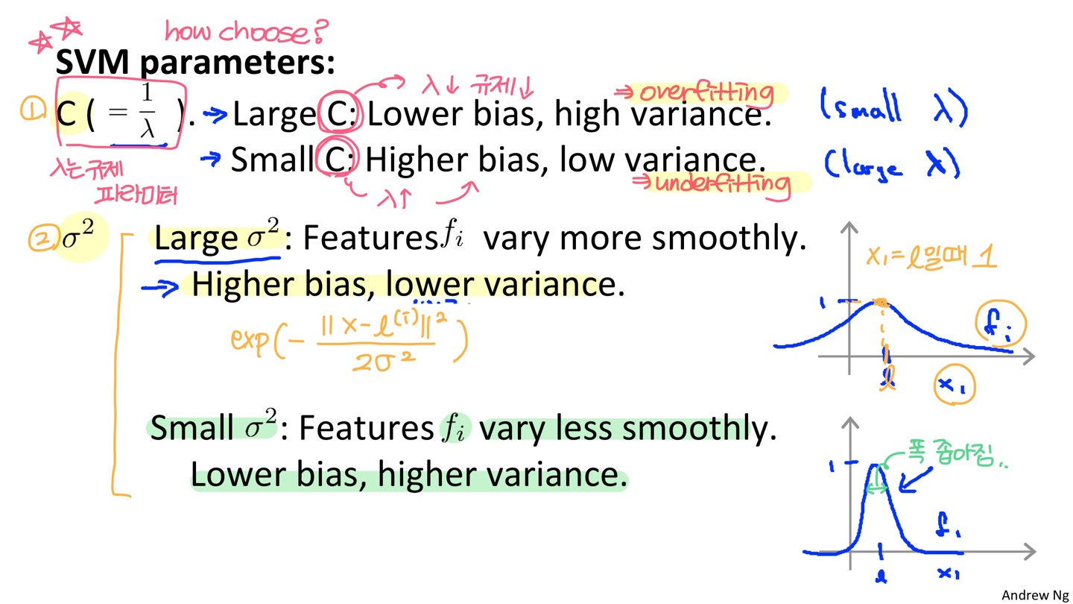
Support Vector Machine (Kernels)

Slide 13
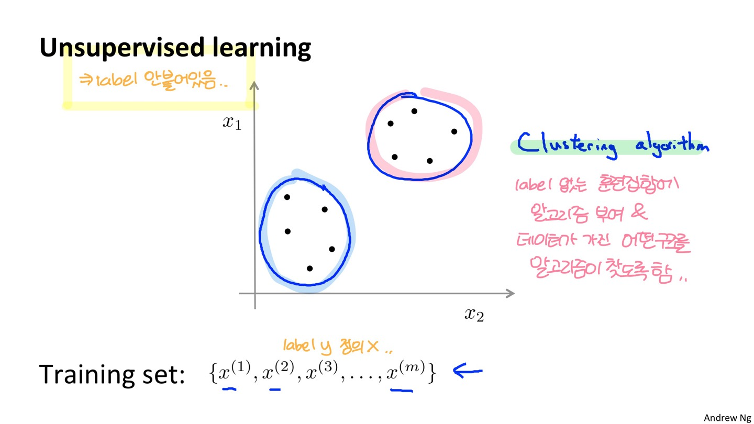
Unsupervised Learning

Slide 14
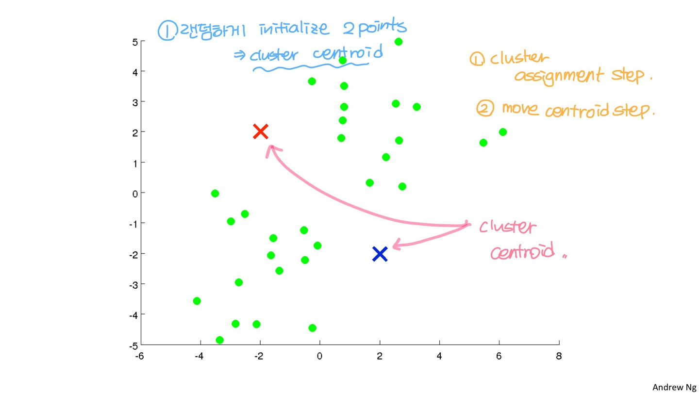
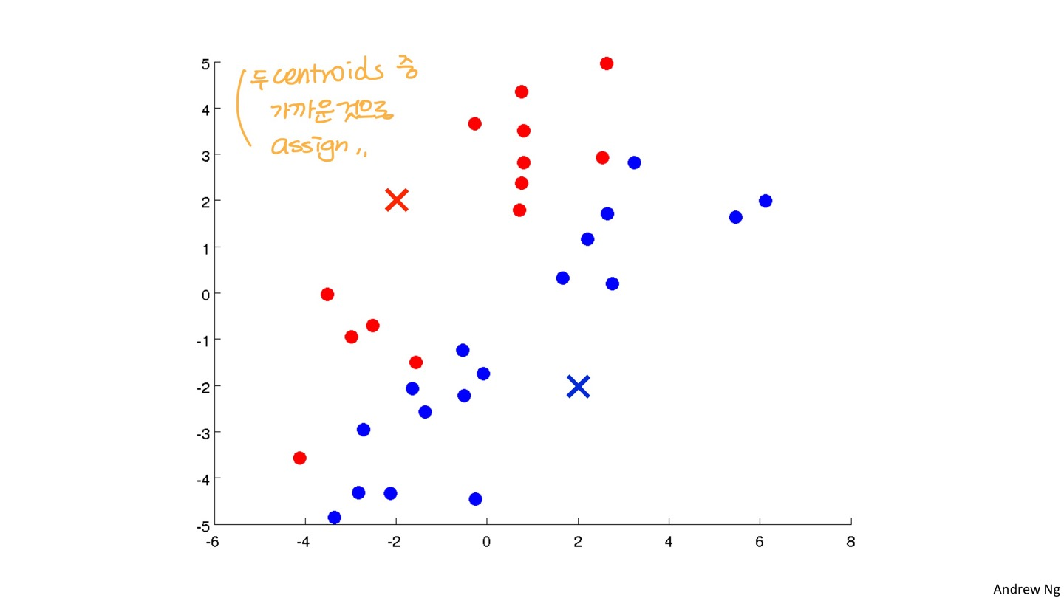
Unsupervised Learning

Slide 15
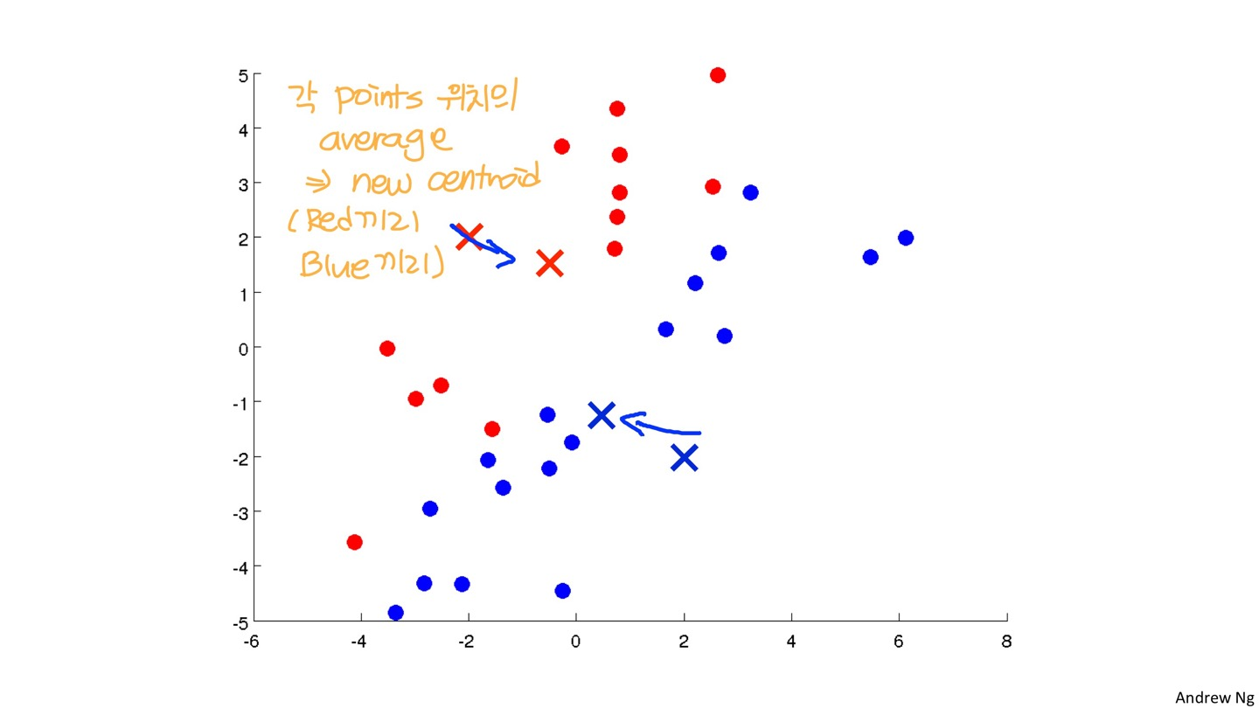
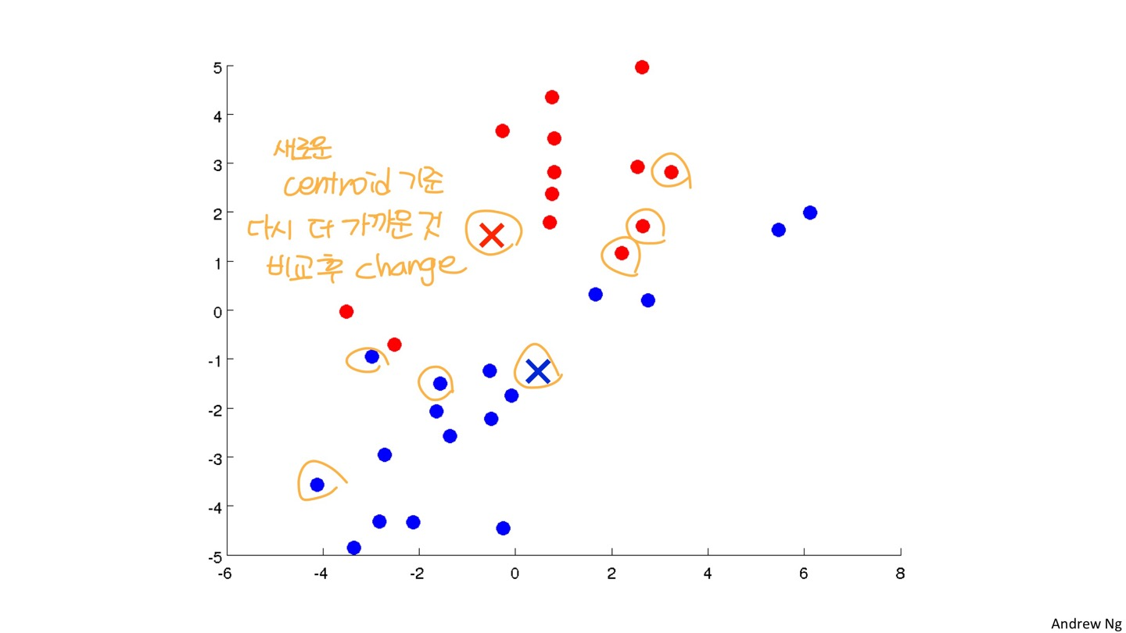
Unsupervised Learning

Slide 16
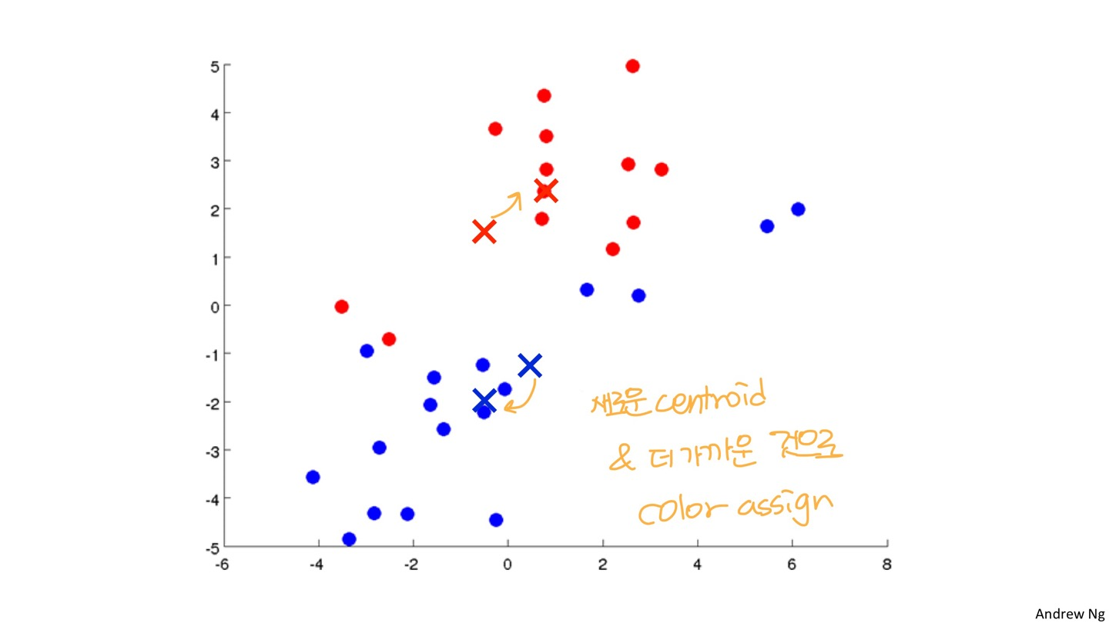
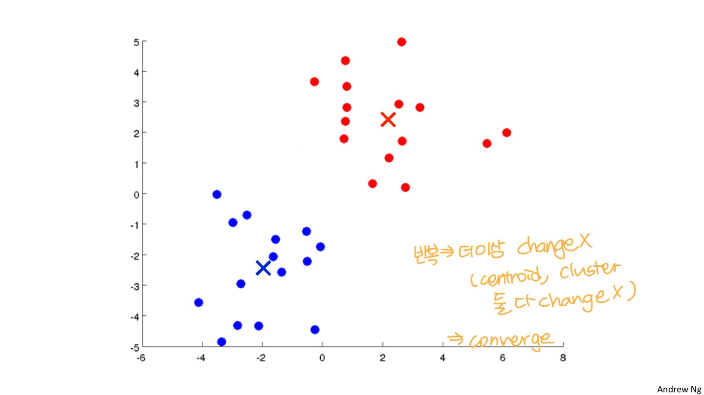
Unsupervised Learning

Slide 17
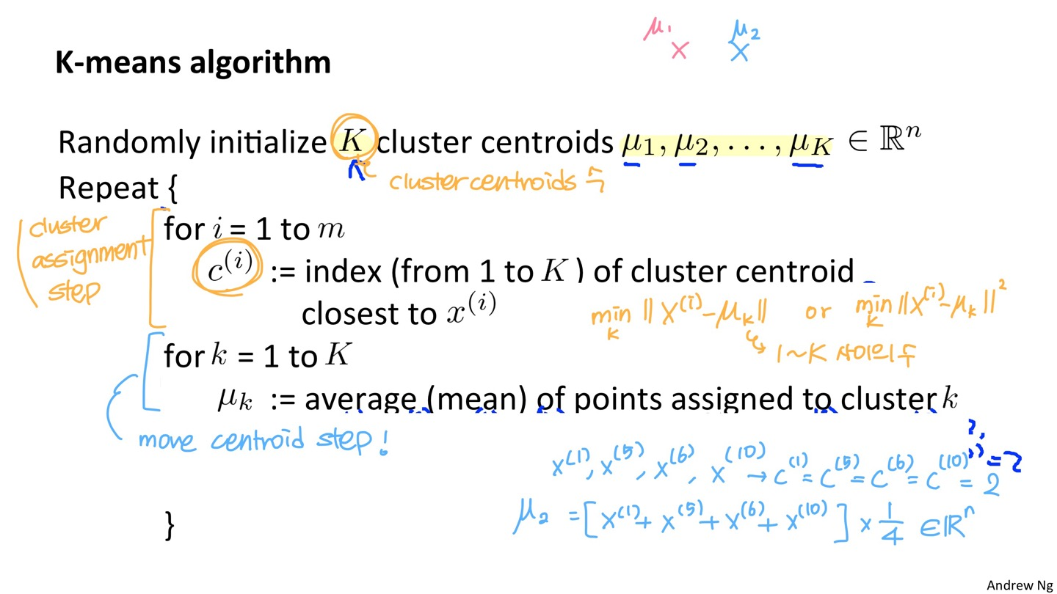
Unsupervised Learning

Slide 18
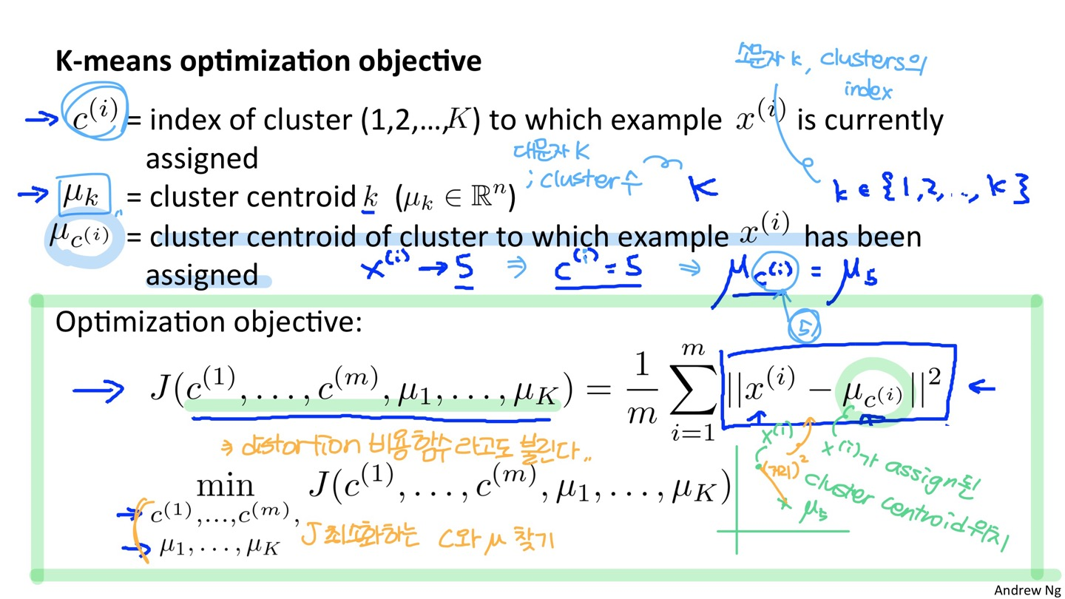
Unsupervised Learning

Slide 19
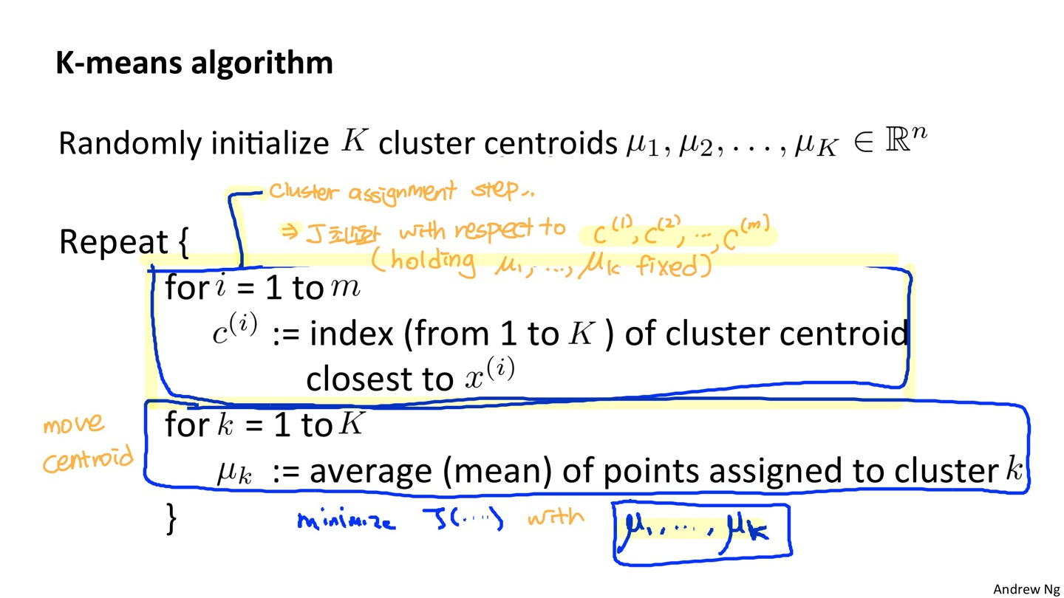
Unsupervised Learning

Slide 20
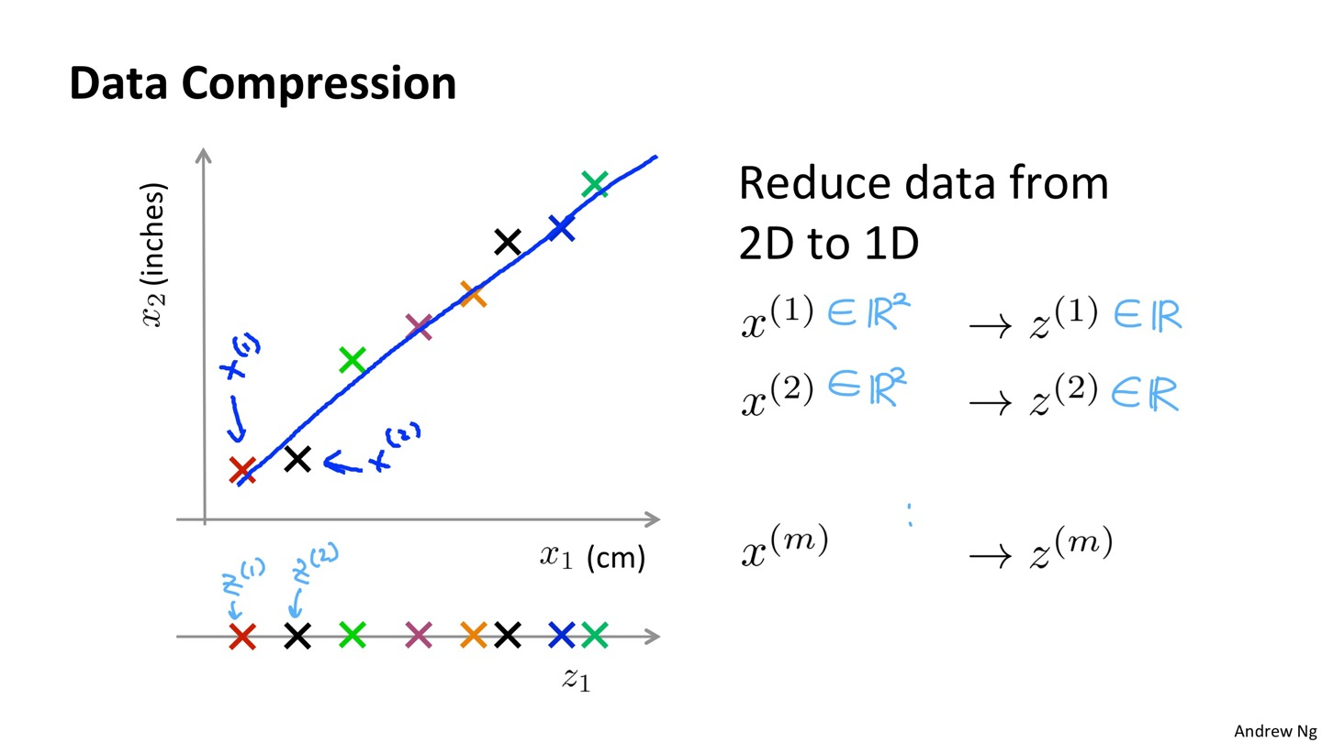
Dimensionality Reduction

Slide 21
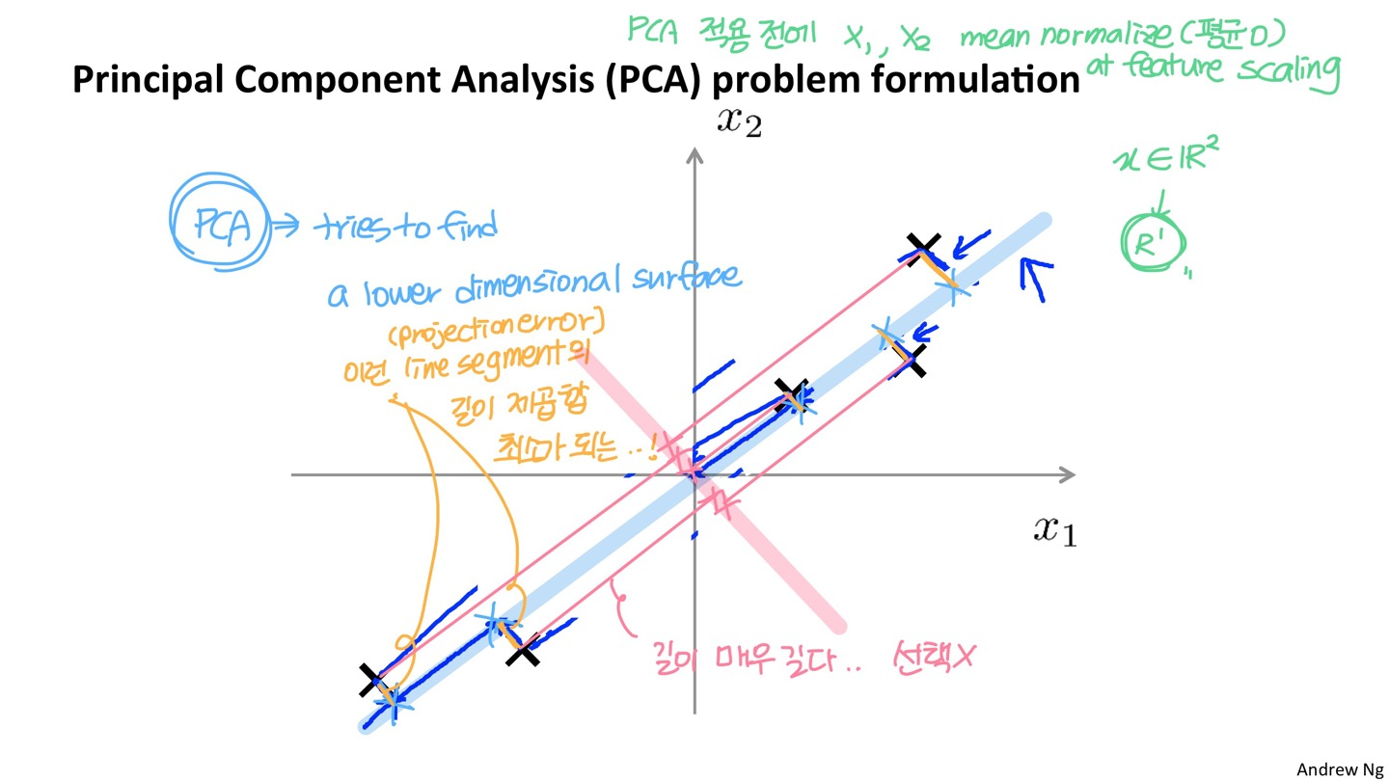
Dimensionality Reduction

Slide 22
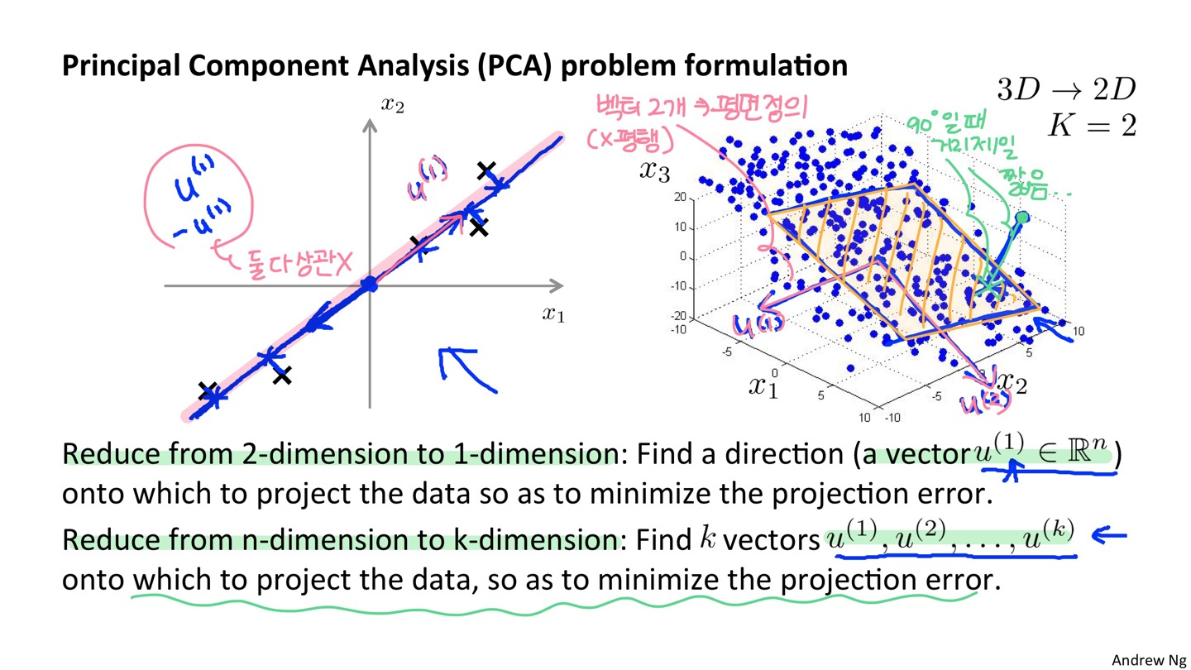
Dimensionality Reduction

Slide 23
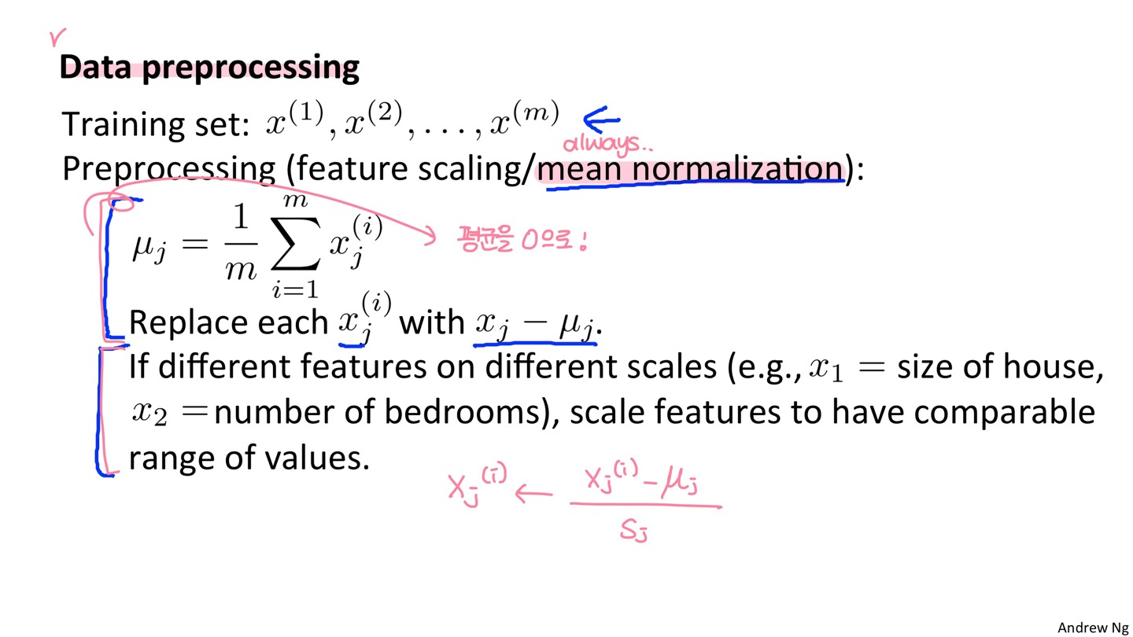
Dimensionality Reduction
PCA 전에 데이터 처리 필요 : mean normalization은 필수

Slide 24
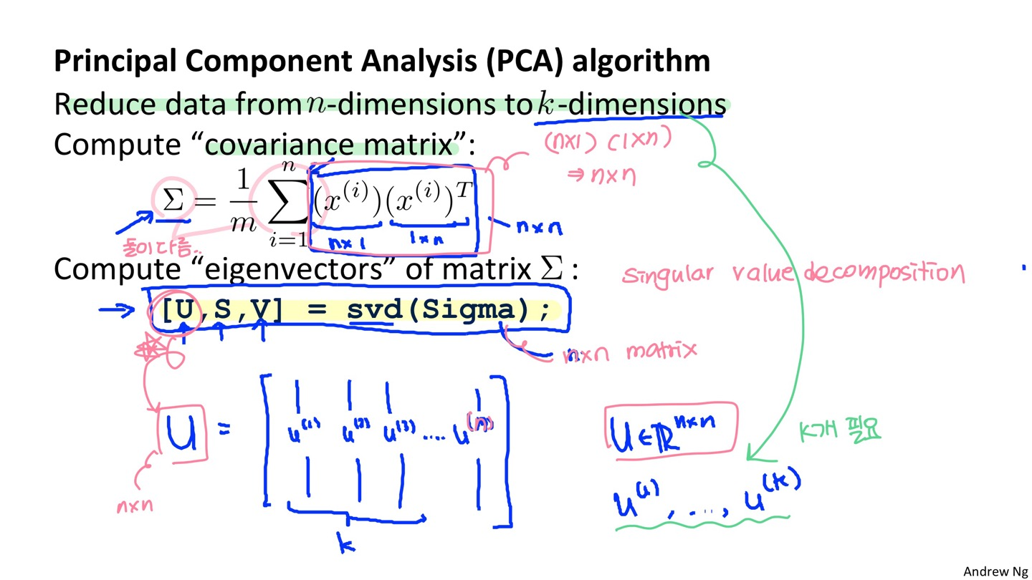
Dimensionality Reduction

Slide 25
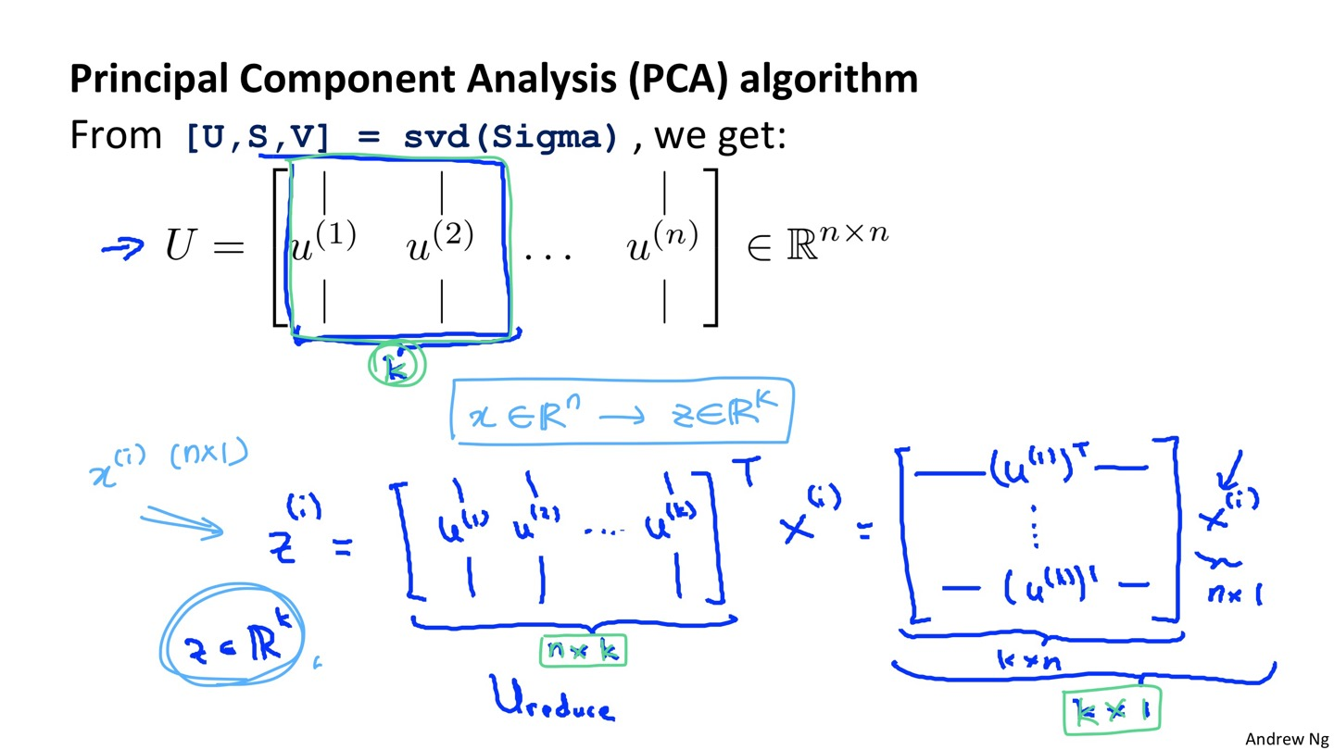
Dimensionality Reduction

Slide 26
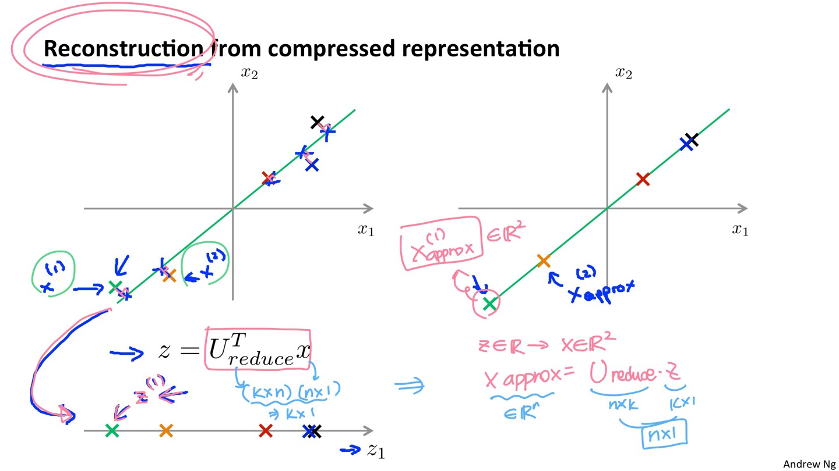
Dimensionality Reduction

Slide 27
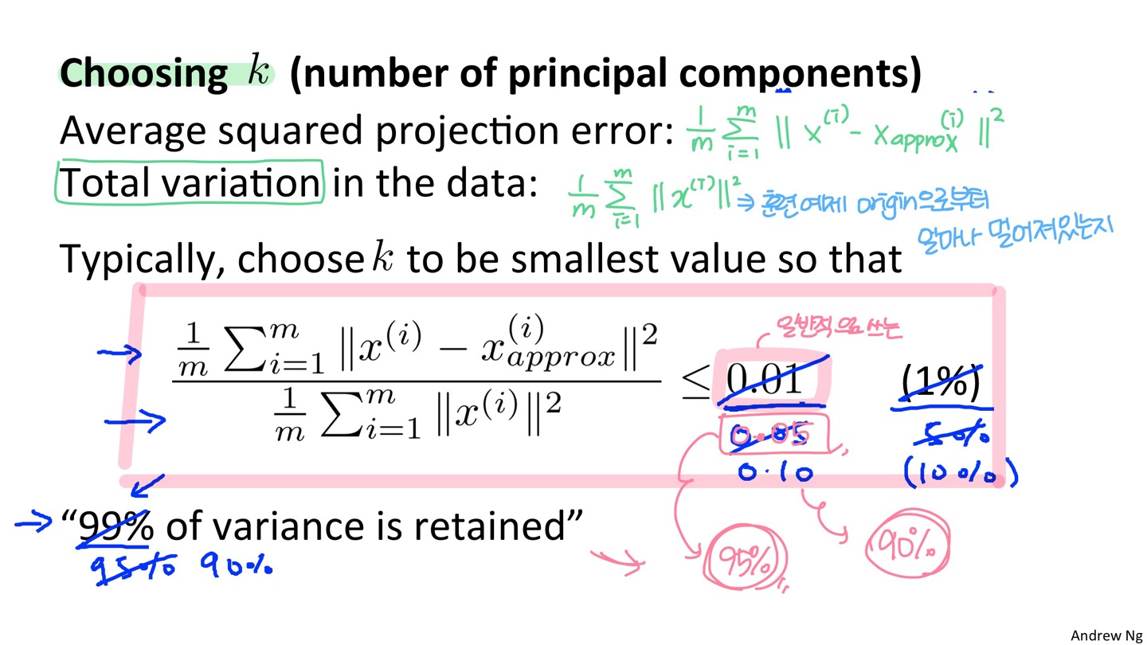
Dimensionality Reduction

Slide 28
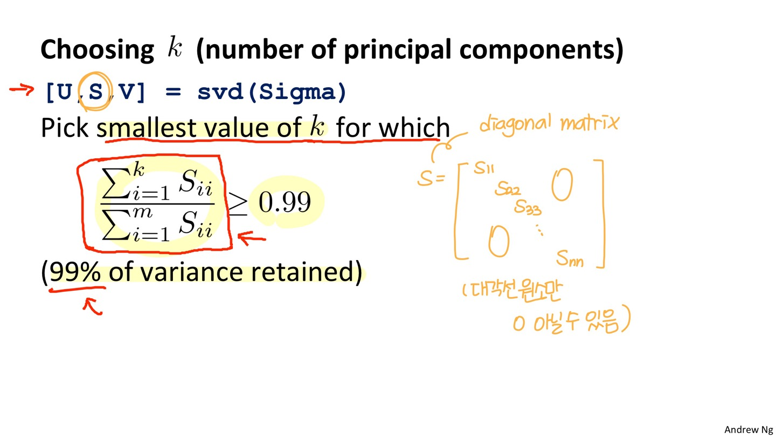
Dimensionality Reduction

Slide 29
감사합니다.

